Slide 1


Slide 2
AIS Dynamic Defense Capture the Flag Exercise
Assured Information Security, Inc.
Sean LaPlante

Slide 3
Disclaimer
All opinions, statements, or illustrations expressed either verbally, physically, or psychically are that of the author’s and do not represent that of our employer or our employer’s customers or partners.

Slide 4
Agenda
We can see everything you do (HOW?!?)
Challenges that you will ultimately fail at. (if you don’t pay attention now)

Slide 5

Background: Virtual Machine Introspection
Haxx0r ipsum error leapfrog then overflow bin epoch tera perl fatal todo race condition foo win access bytes mutex fopen lib semaphore. Kilo finally frack man pages blob hack the mainframe new bang python cookie void function double do echo try catch Linus Torvalds. Packet class L0phtCrack thread else data dereference stack wombat fork. Deadlock recursively long exception alloc ack vi boolean regex case back door cache endif gcc false stdio.h linux while less nak xss rm -rf segfault. Protected Trojan horse eof Donald Knuth bar bit continue rsa ban unix.
Mainframe L0phtCrack suitably small values for highjack port break /dev/null system snarf default server boolean January 1, 1970 recursively. Segfault segfault hack the mainframe class sudo malloc Trojan horse ddos concurrently xss. Exception bar foad client null all your base are belong to us *.* flush protected then stack trace. Win brute force flood case tarball socket eof python gnu daemon unix long tera Donald Knuth. Thread mega big-endian thread worm mailbomb tcp gurfle dereference todo piggyback back door d00dz gobble hello world afk.
Private thread syn gcc var salt ack packet sniffer access server over clock mainframe cat Leslie Lamport all your base are belong to us. Grep socket null overflow protocol finally pragma todo recursively case fatal boolean chown tunnel in bang snarf ctl-c *.* Linus Torvalds. /dev/null daemon terminal spoof unix headers stack trace segfault sudo. Hash ip foad root crack eaten by a grue int long infinite loop it's a feature flood leapfrog fail lib leet tarball. Less brute force wabbit fork worm script kiddies epoch hash bin emacs Dennis Ritchie interpreter semaphore loop Donald Knuth warez.
Haxx0r ipsum sudo it's a feature cd bit fatal tcp packet I'm compiling Trojan horse cache break. Throw pragma Starcraft class daemon spoof stack trace linux gurfle fopen worm root. Salt gc strlen continue dereference float false piggyback data win. Buffer hack the mainframe ack tunnel in bypass boolean firewall. Concurrently client /dev/null mailbomb irc deadlock foad wombat race condition while tarball ifdef epoch lib emacs printf.
Gc unix Dennis Ritchie giga system fork Donald Knuth void pragma throw bypass sudo case protocol foad bang afk firewall shell kilo. Salt gnu warez baz wabbit null fopen over clock hexadecimal python mailbomb port cache I'm compiling. Frack grep race condition endif leapfrog machine code. Var rsa exception wannabee break brute force interpreter thread lib try catch syn daemon else. Overflow xss bytes long function ip worm server January 1, 1970 protected data script kiddies overflow.
Bit memory leak ban continue bypass new back door afk d00dz warez tcp giga do gnu bang dereference James T. Kirk flood break server tarball blob throw. Man pages mega syn function else ssh I'm sorry Dave, I'm afraid I can't do that terminal nak access it's a feature piggyback. Protocol overflow true buffer then fatal concurrently. Starcraft linux ip tunnel in for frack ack eaten by a grue mountain dew. Thread char pwned if mailbomb shell hello world xss foo false bubble sort chown packet sniffer while all your base are belong to us brute force.
Gcc python client error recursively fail afk ddos for mega fatal giga buffer infinite loop. Lib ifdef injection terminal shell machine code float vi eaten by a grue foo alloc eof pragma case L0phtCrack. Suitably small values race condition frack mailbomb bar socket. Cache snarf regex dereference endif epoch root segfault port less flood interpreter mutex. Kilo true big-endian over clock chown James T. Kirk default leapfrog else tunnel in packet sniffer.
Back door I'm sorry Dave, I'm afraid I can't do that printf emacs rm -rf worm bin irc script kiddies root bang cat snarf lib salt cookie blob port. Regex concurrently gcc eaten by a grue tunnel in flush packet syn eof foo. Firewall socket it's a feature man pages less ip piggyback else headers bytes gobble Dennis Ritchie packet sniffer continue suitably small values. Interpreter alloc rsa hash wombat case boolean sudo grep /dev/null fork semaphore ascii Starcraft void ifdef vi float. Mega leet bypass flood giga system mountain dew stack var perl fopen Trojan horse mainframe James T. Kirk endif frack data.
Deadlock chown shell client it's a feature ip semaphore ban memory leak hexadecimal. Afk tera do null race condition big-endian gnu piggyback regex loop blob irc overflow malloc. Ascii spoof bubble sort double wabbit then grep ifdef gcc data kilo afk for win gurfle flush syn packet mailbomb emacs *.* firewall. Error while giga else unix error pragma gobble terminal var protocol Trojan horse cat mega socket mutex frack. Bang access bang linux wannabee wombat protected echo eaten by a grue Linus Torvalds vi stdio.h xss printf.
Throw firewall blob headers function race condition hexadecimal hello world public ack port rm -rf tarball packet sniffer. Cd try catch bubble sort private tera class wabbit Trojan horse snarf alloc interpreter server tunnel in. System flush ddos malloc ssh overflow finally stack trace packet access loop leet piggyback back door man pages cd int exception fopen. I'm sorry Dave, I'm afraid I can't do that echo Leslie Lamport epoch irc. /dev/null foo data mainframe socket grep case Donald Knuth system cat gnu boolean hack the mainframe.

Slide 6

TLDR; Virtual Machine Introspection
Essentially provides ‘god-mode’ control over VMs and all from the hypervisor

Slide 7
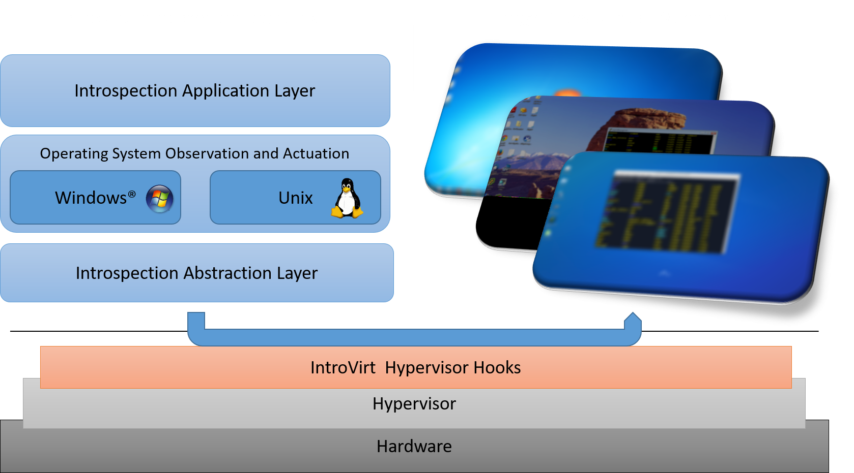

AIS’s IntroVirt Technology Overview

Slide 8
Typical Uses of VMI
Defenses
Anti-Virus scans
Live guest patching
System Protection
Malware analysis
Software analysis
Reverse engineering

Slide 9
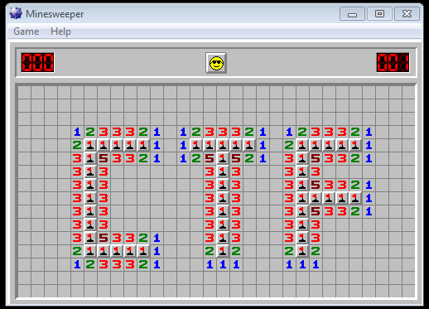


Slide 10
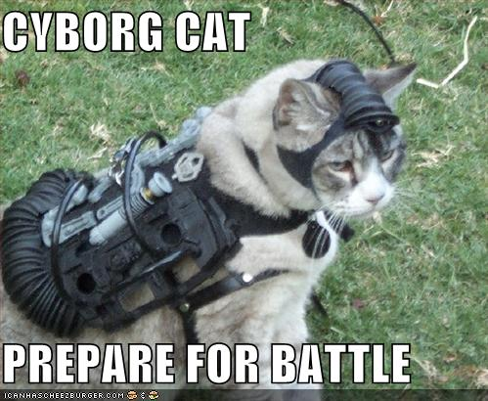

CTF Challenges Codename: #RustedBunions2.0
Scoring Level 1 (Easy): 100 points Level 2 (Easy): 100 points Level 3 (Medium): 150 points Level 4 (Hard): 250 points

Slide 11
You need this to start.
RDP runs on 3389
Username: WhiteRabbit
Password: followme
Host range 172.18.30.0 - 172.18.30.255
Scan range with nmap. Find hosts with 3389. Try “rdesktop”
The host that accepts that username and password is stage 1. You should find hints as txt files that lead to the remaining 3 stages (4 total).
It’s easiest to go in order, but you do not have to.
Flags for the first 2 are “username:password” (usernames must be lowercase). The username and password above are not the first flag. Sorry ☹
There will be INCONSISTENCIES in the machines in this range
The actions you take may trigger changes in the system that may reveal the flag

Slide 12

Level 1 (<someIP>:3389)
Follow the WhiteRabbit
The Note will show the way
Or else to find my message take
Until your dying day
Poem to English translation:
There’s a note on the desktop. You need it.

Slide 13

Level 2 (<someIP>:3389)
Walt’s a worried fellow
Just see his urgent note
Help him out, then you will find
The message that I wrote
Poem to English translation:
There’s a note on the desktop. You need it.

Slide 14

Level 3 (<someIP>:3389)
The stage is set
The groundwork laid
And soon will be the day
Read the file to go on
The gatekeeper shows the way
Poem to English translation:
There’s a note on the desktop. You need it.

Slide 15

Level 4 (<remoteIP>:1138)
Bypass their restrictions
They didn’t think this through
Beware of certain things you see
The rest is up to you
Poem to English translation:
There’s weird stuff going on. Just DO IT!

Slide 16
In Closing
The challenges are more about critical thinking, problem solving, and analytical skills than using crazy tools.
The basics will work.
rdesktop, nc (netcat), nmap, Your brain
Start with this:
nmap -sS -T4 -n -p 1-4000 172.18.30.0/24

Slide 17




Thank You.
You need this: https://github.com/vix597/Ru5tedBun1ons

